Slide 1
MOBILE
DATABASES
SQL PROJECT
-LEKHA PULAVARTHY

Slide 2

INTRODUCTION
With the growing number of smartphone variants and stores, it can be challenging for users to find and compare the availability of their preferred models in real-time.
The lack of an efficient platform that consolidates smartphone availability across multiple stores makes it difficult for users to make quick decisions and track their preferences.

Slide 3

OBJECTIVE
The aim of this project is to create a system that allows users to check the availability of smartphones in various variants across different stores.
01
The system will also enable users to like their preferred variants and keep track of their preferences.
02

Slide 4
NORMALIZATION

Slide 5
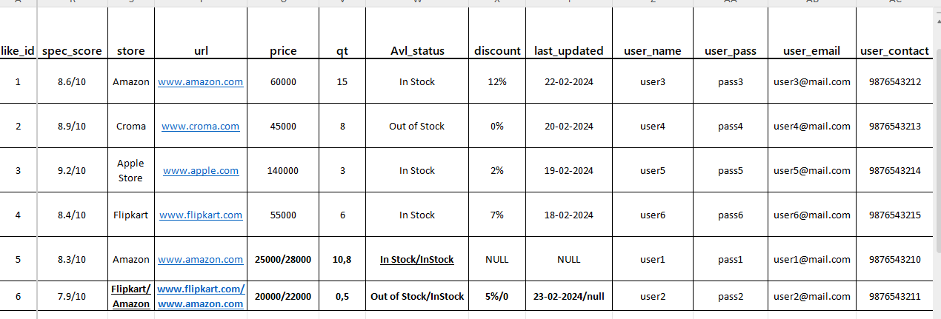
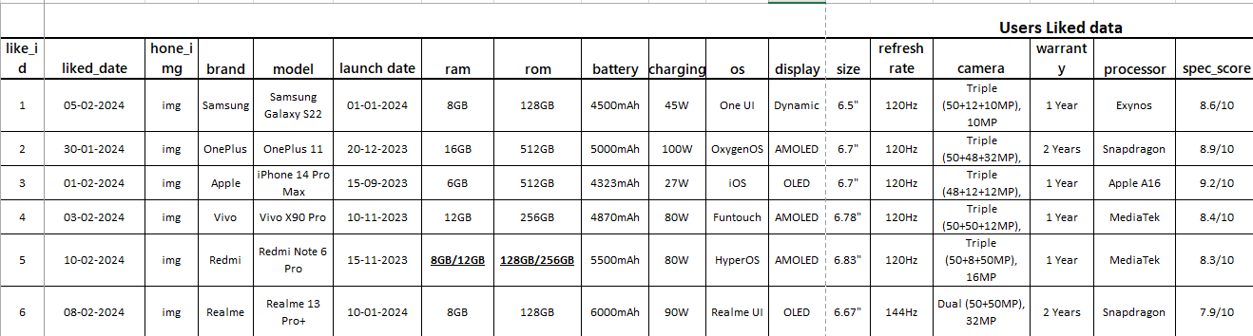
NORMALIZATION
In our project, we store data about smartphone models, their variants (RAM/ROM configurations), and availability across multiple vendors. Initially, we faced two challenges:
Same smartphone available at different vendors – A single model is sold by multiple vendors, causing data duplication and difficulty in tracking stock availability.
Multiple values in the Variant (RAM/ROM) column – Some smartphone models have multiple RAM and ROM configurations, leading to data redundancy and inconsistency.
To solve these issues, we apply normalization, ensuring efficient storage, eliminating redundancy, and maintaining data integrity.

Slide 6
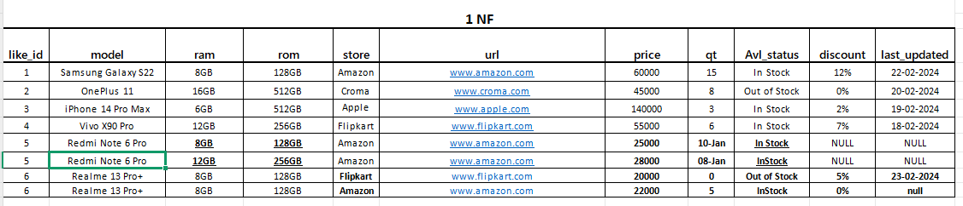
1 NF
Ensures that each column contains atomic values (no multiple values in a single column).
In the context of smartphone variants, multiple RAM/ROM configurations for the same model were initially stored in a single column. To meet 1NF requirements, these values were separated into distinct rows, ensuring each column contains only single, atomic values per entry. This structure allows for better data integrity, easy querying, and avoids redundancy. By doing so, we effectively normalized the data into 1NF.

Slide 7
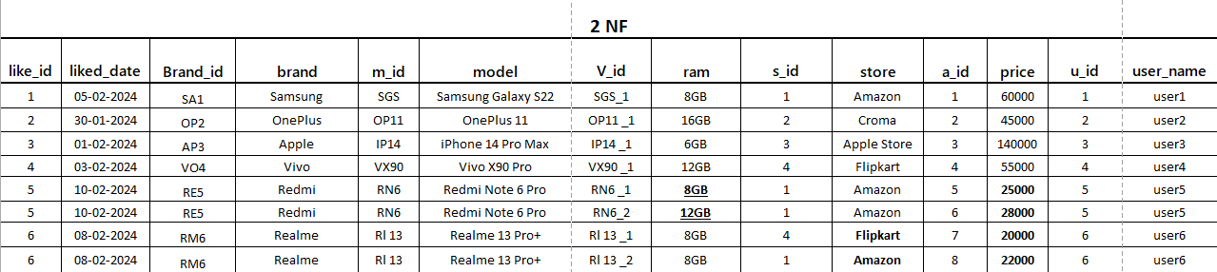
2 NF
Eliminates partial dependencies by ensuring that all non-key attributes are fully dependent on the primary key.
In our database, the primary key initially involved combinations like Phone_Model and Vendor_ID. To resolve this, we introduced unique identifier columns such as Variant_ID and Vendor_ID to ensure that every non-key attribute is fully dependent on the entire primary key.

Slide 8
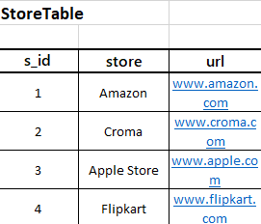
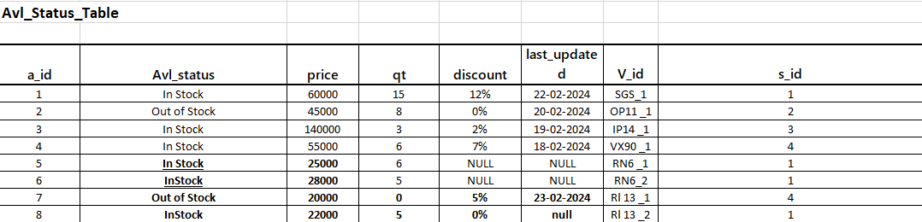
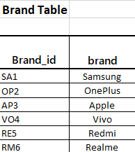
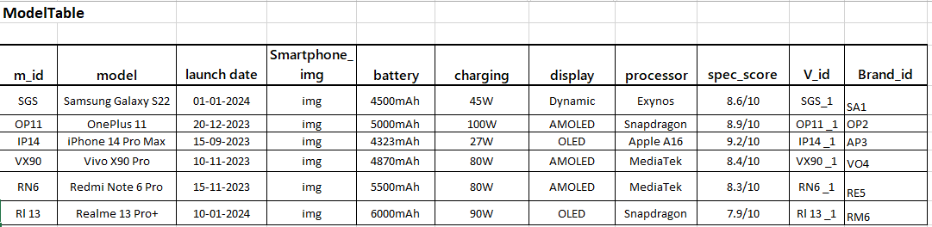
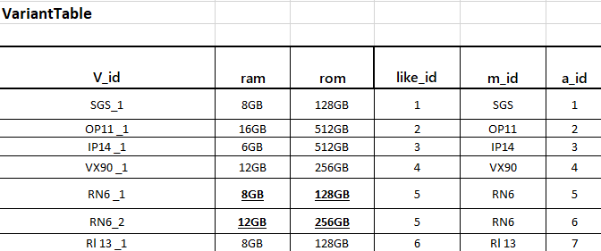
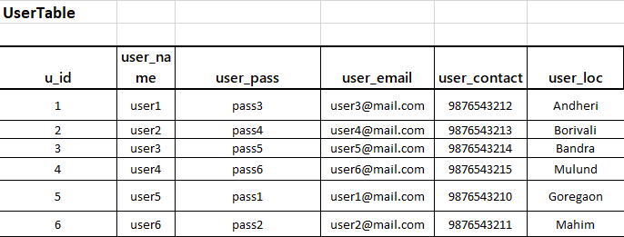
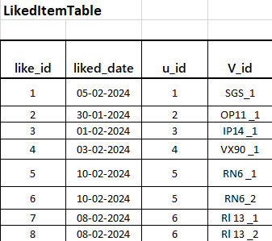
3 NF
Removes transitive dependencies, meaning non-key attributes should not depend on other non-key attributes.
In our database, some non-key attributes, like Vendor_Location, were dependent on other non-key attributes, such as Vendor_Name, instead of directly depending on the primary key. To resolve this,
we separated such attributes into distinct tables, ensuring that every non-key attribute is dependent only on the primary key and not on other non-key attributes.

Slide 9
ER DIAGRAM

Slide 10
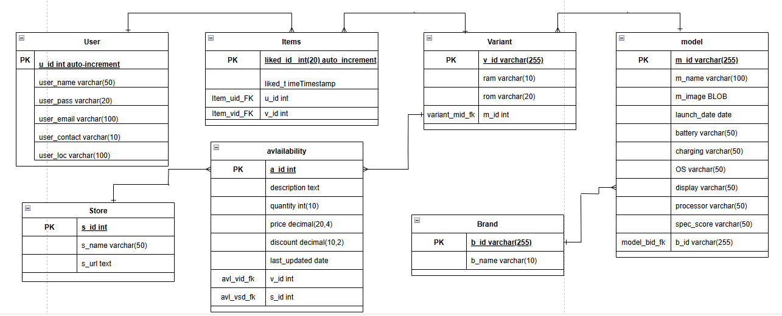
ER

Slide 11
DDL

Slide 12
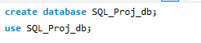
DDL- CREATE
The CREATE command in SQL is a Data Definition Language (DDL) statement used to create database objects such as tables, views, indexes, and schemas. It defines the structure of a database object and specifies the properties of the data to be stored in it.

Slide 13
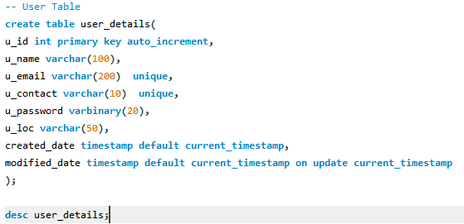
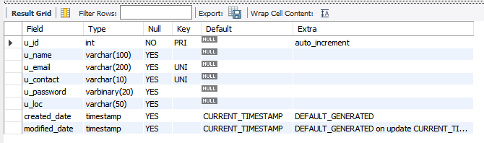
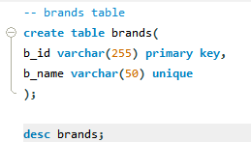
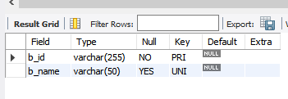
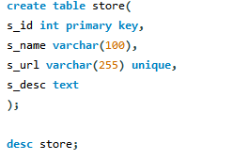
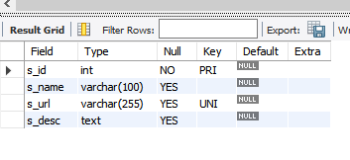
DDL- CREATE
The CREATE command in SQL is a Data Definition Language (DDL) statement used to create database objects such as tables, views, indexes, and schemas. It defines the structure of a database object and specifies the properties of the data to be stored in it.
USER TABLE.
BRAND TABLE.
STORE TABLE.

Slide 14
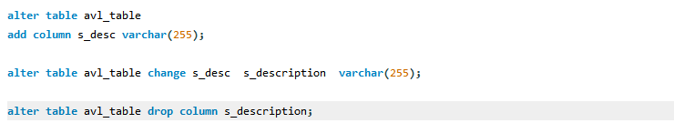
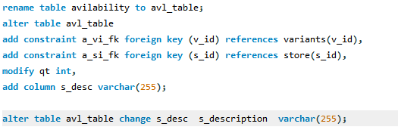
DDL-ALTER/RENAME
The ALTER command in SQL is a Data Definition Language (DDL) statement used to modify the structure of an existing database object. This includes making changes to the schema of tables, columns, constraints, or even indexes.
Adding a Column
Modifying a Column
Adding a Constraint
Dropping a Column
Renaming a Column
Renaming a Table

Slide 15
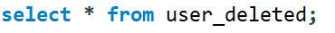
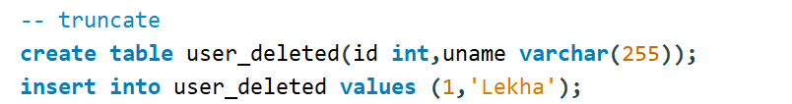
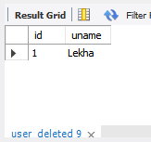
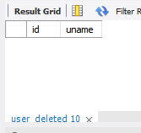
DDL-DROP/TUNCATE
The DROP command in SQL is a Data Definition Language (DDL) statement used to delete database objects such as tables, views, indexes, databases, or constraints. The DROP command permanently removes an object from the database along with all of its data, and it cannot be undone.
SYNTAX : DROP OBJECT <OBJECT_NAME>;
The TRUNCATE command in SQL is a Data Definition Language (DDL) statement used to delete all rows from a table, while keeping the table structure intact. It is often used when you want to quickly remove all data from a table without affecting the schema (e.g., table structure, columns, etc.). Unlike the DELETE command, TRUNCATE does not log individual row deletions and is generally faster for large datasets.

Slide 16
DML

Slide 17
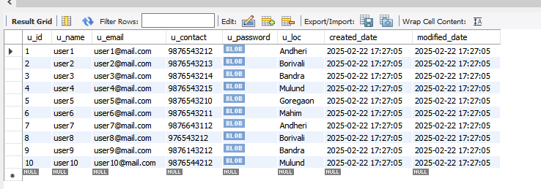
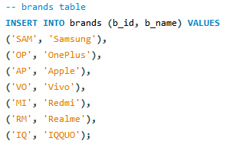

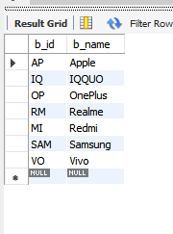
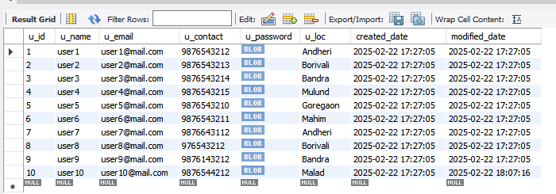
DML-INSERT,UPDATE
The UPDATE command in SQL is used to modify existing records in a table. It allows you to update one or more columns of a table's rows based on a condition specified in the WHERE clause. another table.
The INSERT command in SQL is used to add new rows of data into an existing table. This operation allows you to populate a table with data either by specifying individual column values or by inserting data from another table.

Slide 18
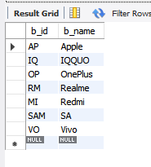
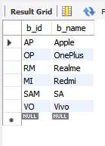
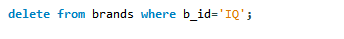
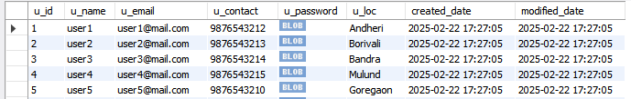
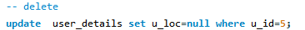
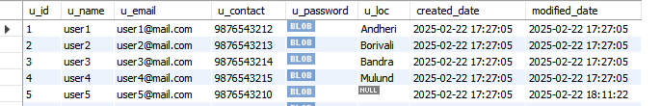
DML-DELETE
The DELETE command in SQL is used to remove one or more rows from a table based on a specified condition. Unlike the TRUNCATE command, which removes all rows from a table, DELETE allows you to specify which rows to delete using the WHERE clause.
DELET SPECIFIC ROWS
DELECT SPECIFIC CONTENT INSIDE FIELD

Slide 19
DQL

Slide 20
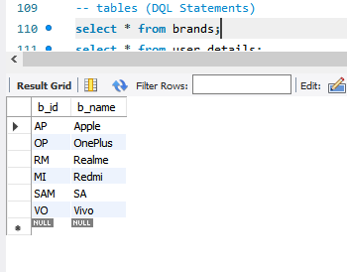
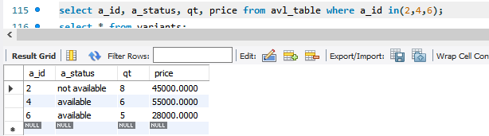
DQL
The SELECT command in SQL is used to query a database and retrieve data from one or more tables. It is one of the most important and commonly used commands in SQL for fetching data, allowing users to filter, sort, and aggregate information.
SELECT COMMAND TO RETRIEVE ALL THE ATTRIBUTES
SELECT COMMAND TO RETRIEVE SPECIFIC THE ATTRIBUTES

Slide 21
OPERATORS

Slide 22
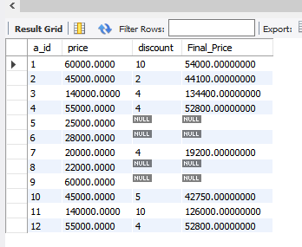
OPERATORS- ARITHMATIC
THE FOLLOWING COMMAND USES VARIOUS ARITHMATIC OPERATORS TO RETURN FINAL AMOUNT AFTER APPLYING DISCOUNT.

Slide 23
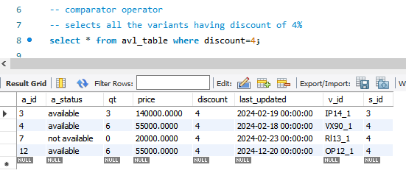
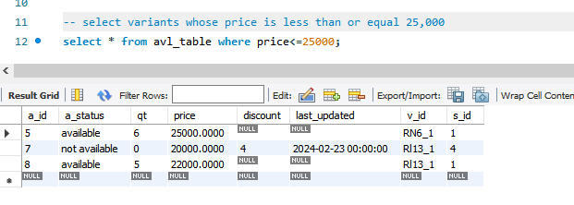
OPERATORS- COMPARATOR
THE FOLLOWING COMMAND USES VARIOUS COMPARATOR OPERATORS
EQUALS TO OPERATOR
LESS THAN OPERTOR

Slide 24
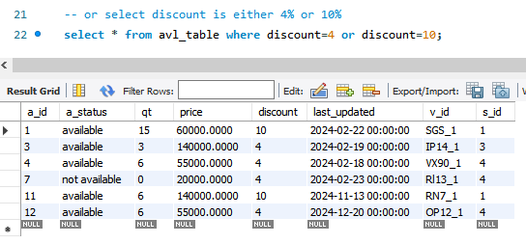
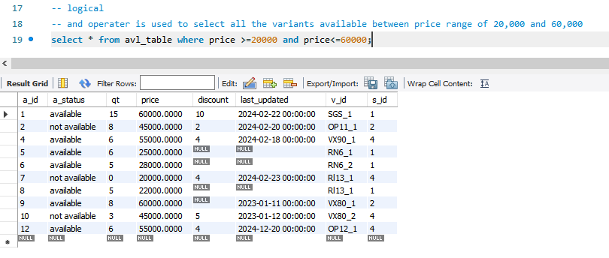
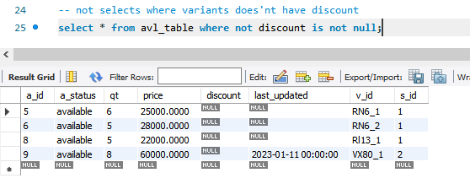
OPERATORS- LOGICAL
OR OPERATOR
AND OPERATOR
NOT OPERATOR

Slide 25
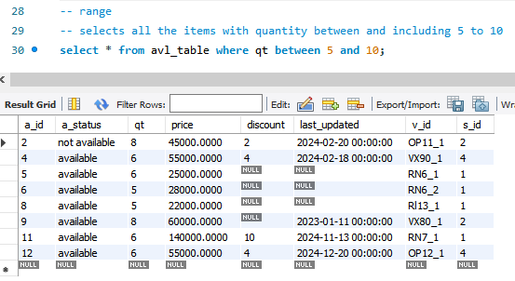
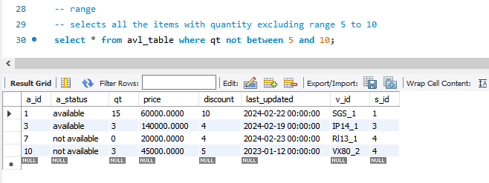
OPERATORS- RANGE
BETWEEN OPERATOR
NOT BETWEEN

Slide 26
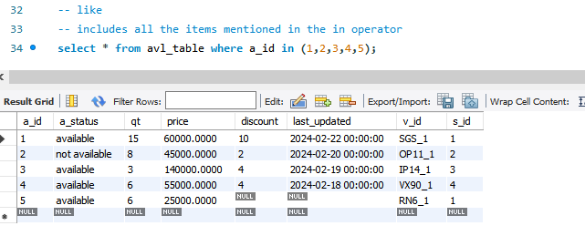
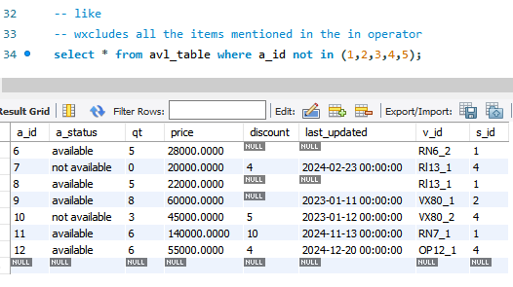
OPERATORS- IN (LIST)
IN
NOT IN

Slide 27
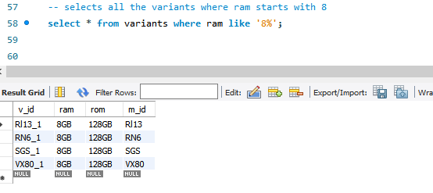
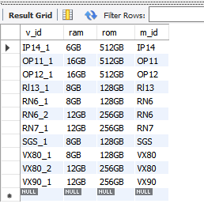
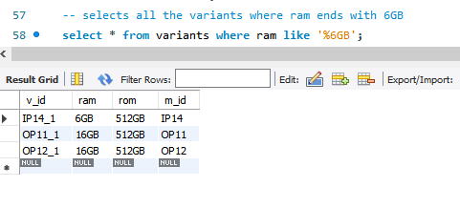

OPERATORS- LIKE
VARIANTS TABLE

Slide 28
BUILT IN FUNCTIONS

Slide 29

STRING FUNCTION
String functions in SQL are used to manipulate or query string values (text data) in various ways, such as extracting substrings, changing case, replacing text, and more.
Types: concat(), lower(), upper(), trim(), replace(), len(), substring(string, start, end) , etc.

Slide 30

mMATH FUNCTION
SQL provides built-in mathematical functions to perform arithmetic and numerical operations on data. These functions are commonly used in SELECT queries to manipulate numeric values.
Types: ABS(), CEIL(), FLOOR(), ROUND(), POWER(), SQRT(),SIN(), …,EXP(), LOG(X), etc.

Slide 31


mDATE FUNCTION
SQL provides date functions to manipulate and format date and time values.

Slide 32

mDATE FUNCTION
SQL provides date functions to manipulate and format date and time values.

Slide 33


AGGREGATE FUNCTIONS WITH GROUP BY & HAVING
Aggregate functions perform calculations on multiple rows and return a single summarized value. They are commonly used with the GROUP BY clause.
Let us use these aggregate functions to perform group by along with having clause.

Slide 34



ORDER BY, DISTINCT, LIMIT, OFFSET
The ORDER BY clause is used to sort the result set returned by a SELECT query in ascending (ASC) or descending (DESC) order. The LIMIT clause is used to restrict the number of rows returned by the query. The OFFSET clause is used in combination with LIMIT (or FETCH) to skip a specified number of rows before starting to return the results.
The DISTINCT clause is used to remove duplicate rows from the result set, returning only unique rows based on the selected columns.

Slide 35


CASE STATEMENT
The CASE statement in SQL is a conditional expression that allows you to implement logic and return specific values based on certain conditions. It's similar to an "IF-ELSE" or "SWITCH" statement in programming languages.

Slide 36
SUBQUERY

Slide 37


SUBQUERY
A subquery is a query inside another query, used to retrieve data that will be used in the main query. It is enclosed in parentheses () and can be used in SELECT, FROM, WHERE, or HAVING clauses.
Corelated SubQuery
Single row SubQuery

Slide 38
JOIN

Slide 39



INNER JOIN
Returns only the rows where there is a match in both tables.

Slide 40



LEFT JOIN
Returns all rows from the left table and matching rows from the right table.

Slide 41



RIGHT JOIN
Returns all rows from the right table and matching rows from the left table..

Slide 42




FULL JOIN
Returns all rows from both tables. If no match, NULL is returned for missing values from either table.

Slide 43



sSELF JOIN
Joins a table with itself.

Slide 44



CROSS JOIN
Returns the Cartesian product of both tables (every row in table A pairs with every row in table B).

Slide 45
WWWWWWWWWWWWWWWWWWWWWWWWWWwwwWWWWWWWWWwww
VIEW

Slide 46


W
VIEW
A View in SQL is a virtual table that is based on the result of a query. It does not store data physically but provides a way to simplify complex queries by saving them as a reusable table-like structure.

Slide 47
FUNCTION

Slide 48


FUNCTIONW
A function in SQL is a reusable block of code that performs a specific task and returns a value. Functions help in modularizing and simplifying SQL queries.

Slide 49
TRIGGER

Slide 50


TRIGGERW
A trigger in SQL is a special type of stored procedure that automatically executes when a specific event occurs in a table, such as INSERT, UPDATE, or DELETE.

Slide 51

TRIGGER

Slide 52


TRIGGER
INITIALLY
LOG TABLE
AVAILABILITY TABLE

Slide 53


TRIGGER
AFTER UPDATE
LOG TABLE
AVAILABILITY TABLE

Slide 54
PROCEDURE AND CURSOR

Slide 55

CURSOR AND PROCEDURE W
START OF PROCEDURE

Slide 56


CURSOR AND PROCEDURE W
PHASES OF CURSOR : START
ERROR HANDLER

Slide 57

CURSOR ALONG PROCEDURE W
OPEN CURSOR
FETCH

Slide 58




CURSOR ALONG PROCEDURE W
RESULTS
CLOSE CURSOR
AFTER THAT END PROCEDURE
CALL PROCEDURE

Slide 59
THANK YOU
THANK YOU
THANK YOU

